Slide 1
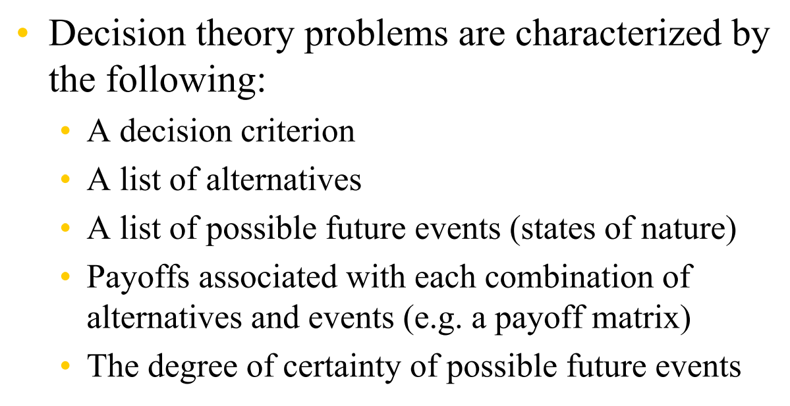

Slide 2
Decision Making Environments
Decisions are made under three types of Environments. They are
Decision making under conditions of Certainty
Decision making under conditions of uncertainty
Decision making under conditions of risk
Decision –making under conditions of certainty
In this environment, only one state of nature exists for each alternative that is, complete
Certainty about the future. It is easy to analyse the situation and make good decisions.
Since the decision maker has perfect knowledge about the future outcomes, the decision
Maker simply chooses the alternative having optimum payoff.

Slide 3
In economic evaluation of alternatives, if the annual revenues of different alternatives are
Known in advance which are not subject to any variation in future then these quantities are deterministic
Quantities and the corresponding decision on the selection of the best alternative is an example
Of decision under certainty.
Decision making under conditions of uncertainty
In this environment, more than one states of nature exist but the decision maker lacks
Sufficient knowledge to assign probabilities to the various states of nature. Situations
like launching a new product fall under this environment

Slide 4
Decision making under conditions of risk
In this environment, more than one states of nature exist but the decision maker
Has sufficient knowledge to assign probabilities to the each of states of nature. These
Probabilities could be obtained from the past records or from simply the subjective
Judgement of the decision maker.
In economic evaluation of alternatives, if the annual revenues of different alternatives are described in the form of a probability distribution

Slide 5
They are five criteria for decision making under uncertainty which are :
Laplace Criterion
Maximax Criterion/Minimin Criterion
Maximin Criterion/Minimax Criterion
Savage minimax regret Criterion
Hurwicz Criterion
Laplace Criterion
In this criterion, the decision maker uses all the information by assigning equal
probabilities to the all states of nature of each alternative decision, calculate the
Expected payoff for the each alternative and selects the alternative as the best associated
with the maximum expected payoff if payoff value is profit/return
With the minimum expected payoff if payoff values is cost/Loss

Slide 6
Example :
The following Table represents 12 possible payoffs for the manufacturing company’s
Expansion decision
States of nature(product demand) Alternatives | High | Moderate | Low | Nil | Expected Payoff
Expand | 50 | 25 | -25 | -45 | 1.25
Construct | 70 | 30 | -40 | -80 | -5
Subcontract | 30 | 15 | -1 | -10 | 8.5
Thus the alternative ‘subcontract’ results in maximum average payoff of 8.5

Slide 7
Example : A retail store desires to determine the optimal daily order size for a perishable item. The store buys the perishable item at the rate of Rs. 80 per kg. and sells at the rate of Rs. 100 per kg. If the order size is more than the demand, the excess quantity can be sold at Rs. 70 per kg. in a secondary market;
Otherwise, the opportunity cost for the store is Rs. 15 per kg for the unsatisfied portion of the demand. Based on the past experience, it is found that the demand varies from 50 kg to 250 kg in steps of50 kg. The possible values of the order size are from 75 kg to 300 kg in steps of 75 kg. Determine the optimal order size which will maximize the daily profit of the store by Laplace criterion.

Slide 8
Maximax Criterion/Minimin Criterion :
This Criterion provides the decision maker with optimistic criterion.
When dealing with profit table, find the maximum of each alternative and then select the alternative with maximum profit as the best alternative.
When dealing with Cost table, find the minimum of each alternative and then select the alternative with minimum cost as the best alternative

Slide 9
Maximin Criterion and Minimax Criterion
According to Maximin criterion, the minimum guaranteed profit is maximized. This criterion provides the decision maker with pessimistic criterion.
First, the minimum profit of each alternative irrespective of the states of nature is determined. Then, select the alternative with maximum profit of these minimum profits as the best alternative
According to Minimax criterion, the maximum guaranteed cost is minimized. This criterion also provides the decision maker with pessimistic criterion.
First, the maximum cost of each alternative irrespective of the states of nature is determined. Then, select the alternative with minimum cost of these maximum costs as the best alternative

Slide 10
Consider the following cost matrix and determine the best order size using the Criterion of Pessimism
Demand Order size | 50 | 100 | 150 | 200 | 250
75 | 50 | 125 | 375 | 375 | 125
150 | 40 | 500 | 100 | 250 | 500
225 | 750 | 550 | 250 | 750 | 125
300 | 500 | 40 | 500 | 400 | 540
The best order size is 75 units

Slide 11
Regret Savage Minimax Criterion
This criterion was developed by L.J.Savage.
First construct the regret table
In the case of profit Table, regret value (Opportunity loss) of ith alternative and jth state of nature is the difference between maximum profit for a jth state of nature and each of the values of in the same state of nature j varying from 1 to m(m-no. of alternatives)
In the case of Cost table, regret value of ith alternative and jth state of nature is the difference between each of the values of in the state of nature j for i varying from 1 to m and the minimum cost for the same state of nature j
Then, apply the minimax criterion to the regret table to obtain the best alternative

Slide 12
Consider the following profit table
State of Nature Alternatives | E1 | E2 | E3 | E4 | E5
A1 | 750 | 1125 | 375 | -375 | -1125
A2 | 0 | 1500 | 3000 | 2250 | 1500
A3 | -750 | 750 | 2250 | 3750 | 4125
A4 | -1500 | 0 | 1500 | 3000 | 4500
Regret Table
 | 0 | 375 | 2625 | 4125 | 5625
 | 750 | 0 | 0 | 1500 | 3000
 | 1500 | 750 | 750 | 0 | 375
 | 2250 | 1500 | 1500 | 750 | 0
The third alternative A3 is the best alternative

Slide 13
Hurwicz Criterion : In the case of maximization problem, maximax criterion will give the optimistic solution and maximin criterion will give the pessimistic solution. In the case of minimization problem, minimin criterion will give the optimistic solution amd minimax criterion will give the pessimistic solution.
Hurwicz criterion aims to strike a balance between the extreme optimism and the extreme pessimism by assigning a weight of α to the optimism and 1-α to the pessimism. The range of α is from 0 to 1. Depending on the decision making situation, the value of α will be decided. In the absence of any bias either towards optimism or pessimism, one can assume 0.5 for α

Slide 14
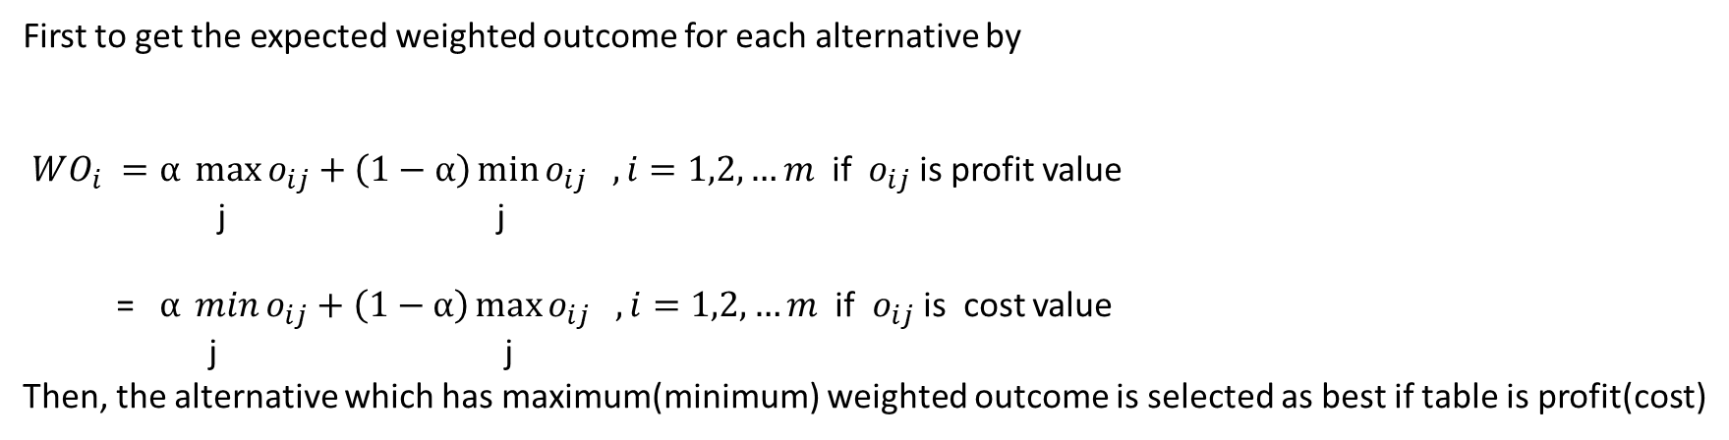

Slide 15
Example : The conditional payoff(Profit in Rs.) of different courses of action (Alternatives) against the state of nature are given in the following Table.
Course of action/ State of Nature | A1 | A2 | A3
N1 | 4000 | 20000 | 20000
N2 | -100 | 5000 | 15000
N3 | 6000 | 400 | -2000
N4 | 18000 | 0 | 1000
Let α=0.7 be the degree of optimism
WO(A1)=12570; WO(A2)=14000 ; WO(A3)=13400
Hence, Max{ WO(Ai)}=14000
Therefore, the alternative A2 is the Best alternative

Slide 16
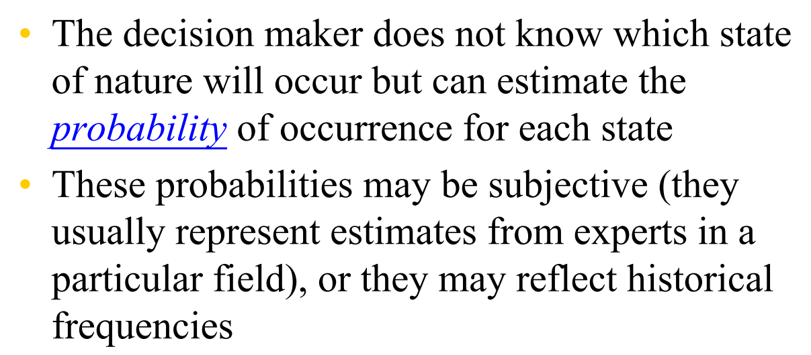

Slide 17
Decision Making Under Risk
The criteria for evaluating the course of action to take a decision under risk are
Expected Monetary Value(EMV)
Expected Opportunity Loss(EOL)
Expected Profit of Perfect Information(EPPI)
Expected value of Perfect Information(EVPI)

Slide 18
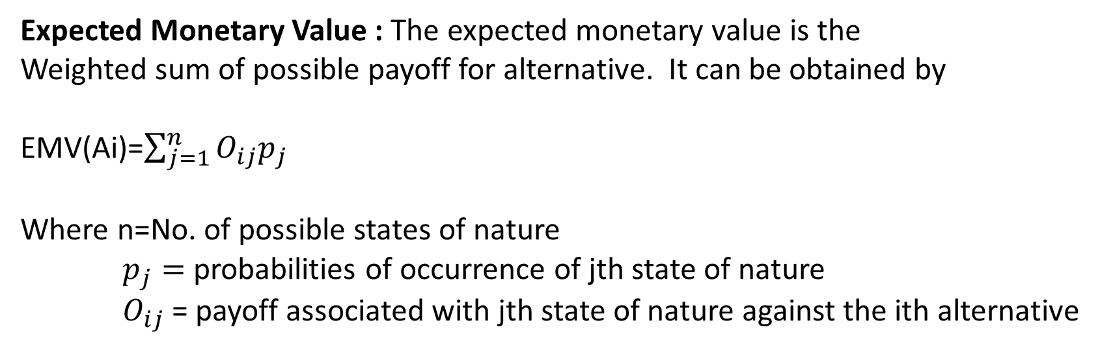
Expected Monetary Value : The expected monetary value is the
Weighted sum of possible payoff for alternative. It can be obtained by
EMV(Ai)=$\sum_{j=1}^{n}{O_{ij}p_{j}}$
Where n=No. of possible states of nature
$p_{j}=$ probabilities of occurrence of jth state of nature
$O_{ij}$ = payoff associated with jth state of nature against the ith alternative
Calculate EMV for each alternative and
select the alternative corresponds to the maximum EMV as the best alternative if payoff is profit
select the alternative corresponds to the minimum EMV as the best alternative if payoff is cost

Slide 19
Example :
A person who just retired from service has received a big provident fund amount. He want to invest this amount in the share market. A broker offers him the following investment alternatives and percentage return rate.
Market conditions Investment | Low | Medium | High
Regular Shares | -5% | 10% | 15%
Risky Shares | -8% | 12% | 20%
Property | -10% | 15% | 25%
Over the past 200 days the market conditions had medium returns rate for 100 days
and high returns rate for 40 days. Using EMV concepts , find the best investment policy
for the investment.

Slide 20
The Payoff(conditional profit) table is
State of Nature Alternatives | Low | Medium | High | EMV
Probability | 0.30 | 0.50 | 0.20
Regular Shares | -0.05 | 0.10 | 0.15 | 0.065
Risky Shares | -0.08 | 0.12 | 0.20 | 0.076
Property | -0.10 | 0.15 | 0.25 | 0.095
From the above table, the alternative property gives the maximum EMV of 9.5%. Therefore, the person should invest in property as it would be the optimum investment policy

Slide 21
Example: A newspaper boy has the following probabilities of selling a magazine
No. of Copies Sold | 10 | 11 | 12 | 13 | 14
Probability | 0.10 | 0.15 | 0.20 | 0.25 | 0.30
Cost of copy is Rs.30 and sale price is Rs. 50. He cannot return unsold copies
How many copies should he order?
Conditional profit table (Rs.)
Possible Demand Order Size | 10 | 11 | 12 | 13 | 14 | EMV
Probability | 0.10 | 0.15 | 0.20 | 0.25 | 0.30
10 | 200 | 200 | 200 | 200 | 200 | 200
11 | 170 | 220 | 220 | 220 | 220 | 215
12 | 140 | 190 | 240 | 240 | 240 | 222.5
13 | 110 | 160 | 210 | 260 | 260 | 220
14 | 80 | 130 | 180 | 230 | 280 | 205
Optimum order size is 12 copies and average profit is Rs.222.5

Slide 22
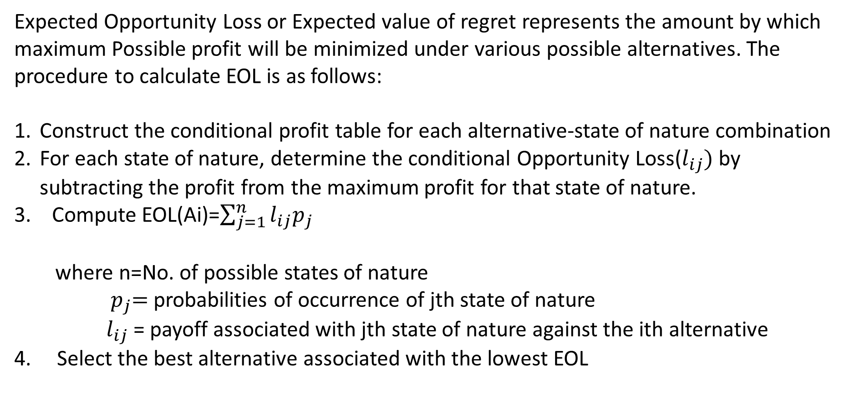
Expected Opportunity Loss (EOL) Criterion
Expected Opportunity Loss or Expected value of regret represents the amount by which maximum Possible profit will be minimized under various possible alternatives. The procedure to calculate EOL is as follows:
Construct the conditional profit table for each alternative-state of nature combination
For each state of nature, determine the conditional Opportunity Loss($l_{ij})$ by subtracting the profit from the maximum profit for that state of nature.
3. Compute EOL(Ai)=$\sum_{j=1}^{n}{l_{ij}p_{j}}$
where n=No. of possible states of nature
${ p}_{j}=$ probabilities of occurrence of jth state of nature
$l_{ij}$ = payoff associated with jth state of nature against the ith alternative
4. Select the best alternative associated with the lowest EOL

Slide 23
Example : Consider the Newsboy problem
The conditional loss table is
Possible Demand Order Size | 10 | 11 | 12 | 13 | 14 | EOL
Probability | 0.10 | 0.15 | 0.20 | 0.25 | 0.30
10 | 0 | 20 | 40 | 60 | 80 | 50
11 | 30 | 0 | 20 | 40 | 60 | 35
12 | 60 | 30 | 0 | 20 | 40 | 27.5
13 | 90 | 60 | 30 | 0 | 20 | 30
14 | 120 | 90 | 60 | 30 | 0 | 45
The optimum stock action is the one which will minimize expected opportunity losses; this action calls for the stocking of 12 copies each day, at which point there
Is minimum expected loss of Rs. 27.5.

Slide 24
Expected Profit with Perfect Information(EPPI)
It is defined as the maximum monetary value that can be obtained on the basis of
having perfect information about the state of nature that will occur. The procedure
for calculating the EPPI is as follows:
Select the best alternative for each state of nature with its associate conditional payoff
from the payoff table
Multiply each conditional payoff chosen in step1 with the corresponding probability
of occurrence of that state of nature
3. Add all these product to get the required EPPI

Slide 25
The conditional profit table under certainty is
Possible Demand Order Size | 10 | 11 | 12 | 13 | 14
Probability | 0.10 | 0.15 | 0.20 | 0.25 | 0.30
10 | 200 | 200 | 200 | 200 | 200
11 | 170 | 220 | 220 | 220 | 220
12 | 140 | 190 | 240 | 240 | 240
13 | 110 | 160 | 210 | 260 | 260
14 | 80 | 130 | 180 | 230 | 280
EPPI=200*0.10+220*0.15+240*0.20+260*0.25+280*0.30=250

Slide 26
Expected Value of Perfect Information(EVPI)
The Expected value of perfect information is the expected or average return in the long run if we have perfect information before a decision has to be made. It is defined as the maximum amount that the decision maker should be willing to pay to obtain the perfect information about the state of nature that would occur. It is computed by EVPI=EPPI – Maximum EMV. It is equal to the minimum EOL
Example
Consider the Newsboy Problem,
EVPI= 250-222.5=27.5

Slide 27
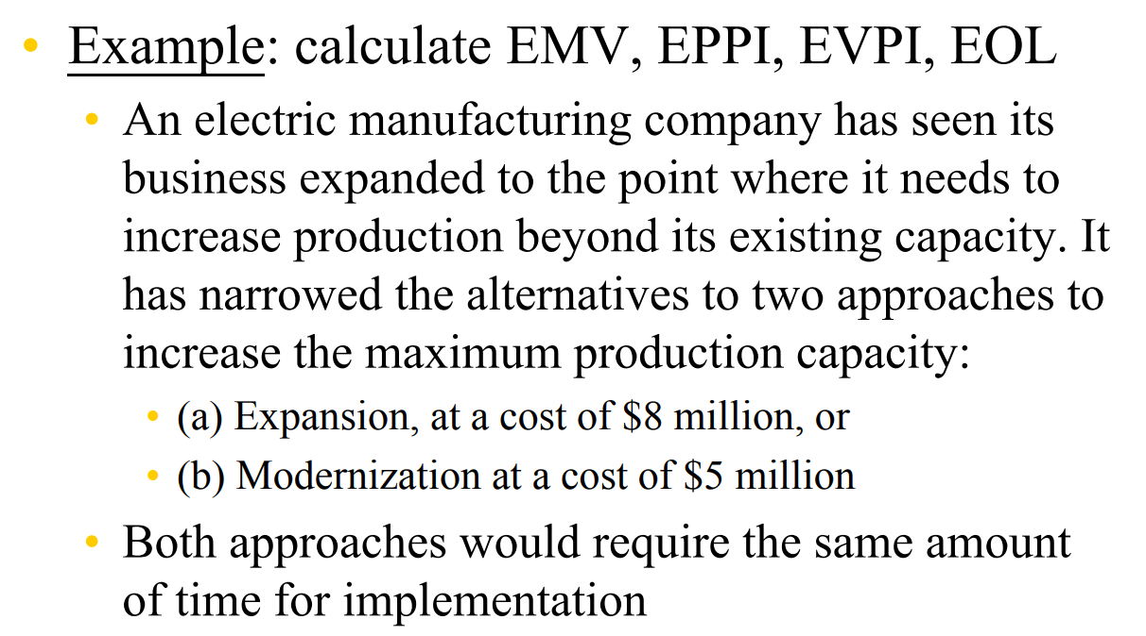

Slide 28
Example : A department store with a bakery section is faced with the problem of how many cakes
To buy in order to meet the day’s demand. The departmental store prefers not to sell day-old cakes
Left over cakes are therefore, a complete loss. On the other hand, if a customer desires a cake but all of them have been sold , he will buy elsewhere and sales will be lost. The store has therefore, collected information on the past sales based on selected 100-day period as shown in the table below. A cake cost Rs. 20 and sells for Rs.25
Sales per day | 15 | 16 | 17 | 18
No. of days | 20 | 40 | 30 | 10

Slide 29
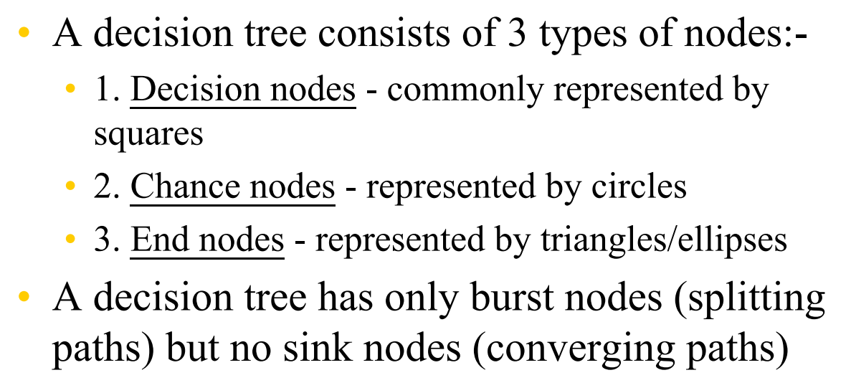

Slide 30
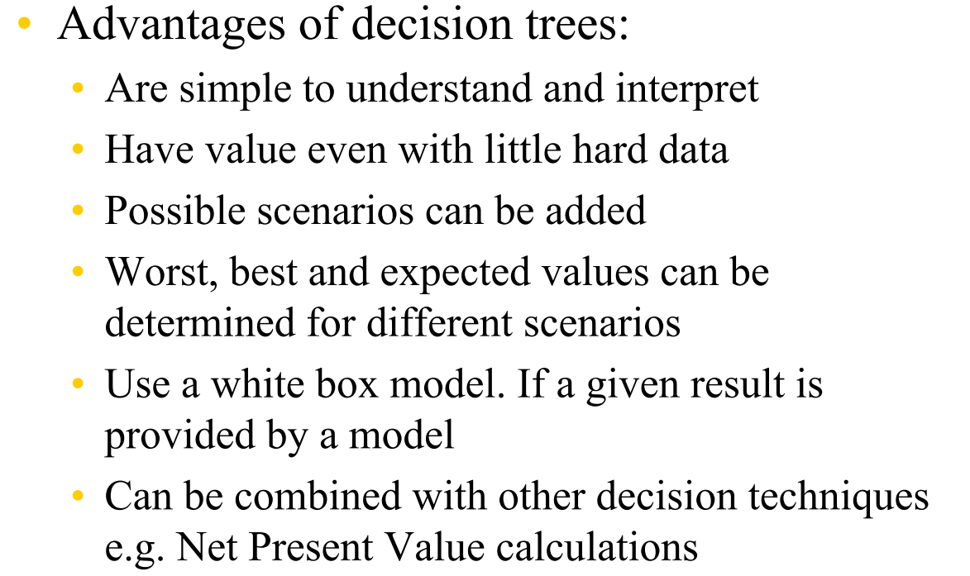

Slide 31
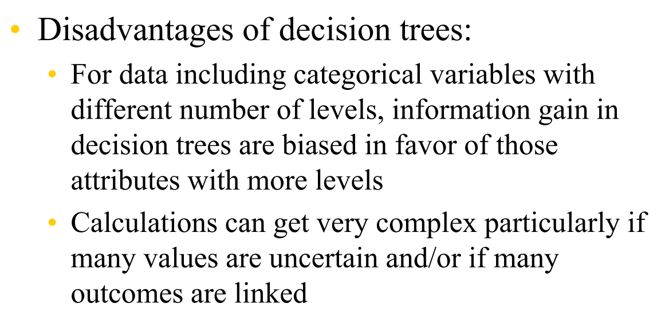

Slide 32
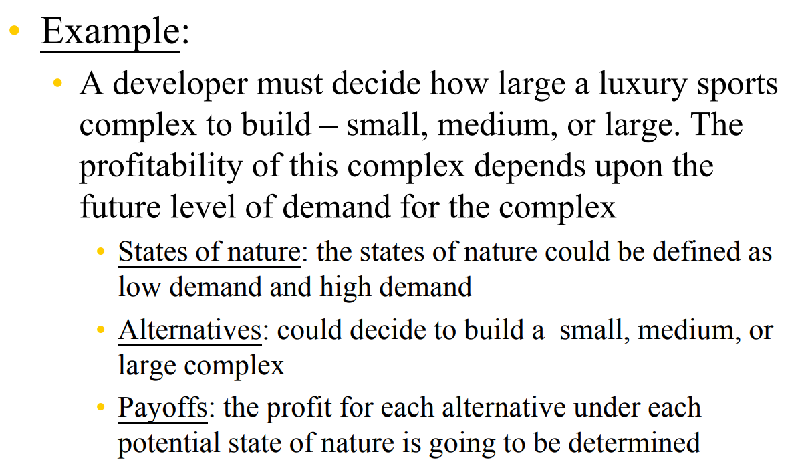

Slide 33
